Slide 1
Predicting Influencers in a Social Network
Group 11
Ashkay Mehra
Sayam Ganguly
Patrick Green

Slide 2
Problem Overview
Problem Definition
Predict the human judgement about which of two users is more influential in a social network, given twitter activity data for the pair.
Data Set
Numeric features for pairs of users (A and B). Both training and test data sets provided.
Follower/Following Count
Mentions Sent/Received
Retweets Sent/Received
Post Count
Listed Count (count of inclusion in user-created categories or lists)
Network Features (proprietary calculated features)
TODO – Baseline Solution (do we need this?)

Slide 3
Approach
Pre-processing
Feature Selection – determine which features correlate with influence
Feature Transformations – normalize data
Modeling Methods
Logistic Regression
Neural Network
Support Vector Machines (SVM)
Ensemble
Evaluation
Measuring the area under the Receiver Operating Characteristic (ROC) curve, which plots true positives against false positives for probabilistic outcomes for a range of thresholds. (TODO – Add Sample)

Slide 4
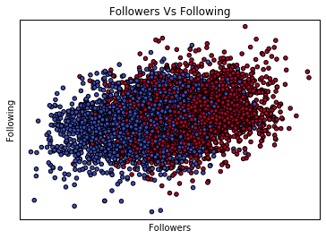
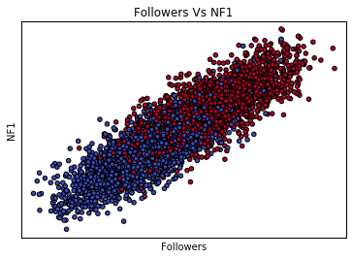
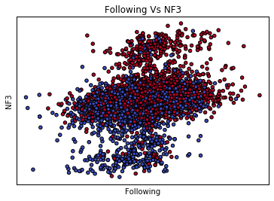
Feature Selection
Feature Selection (add Graphs)
Intuitive
PCA(Akshay)
K-Best(sayam)
Original Features(Matlab Sayam)

Slide 5
Feature Transformation
Delta Transform
Absolute difference between values for two users
Baseline
Preserves the meaning of large difference in values
Binary Transform
Reduce difference to one (larger for user A) or zero (larger for user B)
Simpler data set, but discards the magnitude of differences
Logarithm
Reduces large differences in the orders of magnitude in features (ie. follower versus following counts)
Simplifies non-linear relationships between input and output.
TODO – Add comparison graph for logistic regression
TODO - Normalization

Slide 6
How does the data look like?
Graph(Akshay)

Slide 7
Models
Logistic Regression
Graphs on data transform
Graphs tweaking performance
Talk about Overfitting

Slide 8
Models
SVM
Graphs on data transform
Graphs tweaking performance
Talk about Overfitting

Slide 9
Models
NN
Graphs on data transform
Graphs tweaking performance
Talk about Overfitting

Slide 10
Models
Ensemble
Graphs on data transform
Graphs tweaking performance
Talk about Overfitting

Slide 11
Model Comparison
Compare Best Graphs with Accuracy (ROC)

Slide 12
Conclusion

Slide 13
Thanks!!

